Slide 1
Subject: Programming in Python
Part-2
CSE3&IT
Neha Chadha
IT Department
Notes:
hi
bye

Slide 2
Anonymous Functions
In Python, anonymous function means that a function is without a name. As we already know that def keyword is used to define the normal functions and the lambda keyword is used to create anonymous functions.
Syntax
lambda arguments: expression

Slide 3
Global Variable
a=7
def sum():
# a=4
global a
a=9
b=5
c=a+b
return c
print(sum())

Slide 4
Importing module
Import modulename
dir(modulename)
Eg: Import random
dir(random)
Eg: Import math
dir(math)
Notes:
hi
bye

Slide 5
dir(math) Eg
['__doc__', '__loader__', '__name__', '__package__', '__spec__', 'acos', 'acosh', 'asin', 'asinh', 'atan', 'atan2', 'atanh', 'ceil', 'copysign', 'cos', 'cosh', 'degrees', 'e', 'erf', 'erfc', 'exp', 'expm1', 'fabs', 'factorial', 'floor', 'fmod', 'frexp', 'fsum', 'gamma', 'gcd', 'hypot', 'inf', 'isclose', 'isfinite', 'isinf', 'isnan', 'ldexp', 'lgamma', 'log', 'log10', 'log1p', 'log2', 'modf', 'nan', 'pi', 'pow', 'radians', 'sin', 'sinh', 'sqrt', 'tan', 'tanh', 'tau', 'trunc']
Notes:
hi
bye

Slide 6
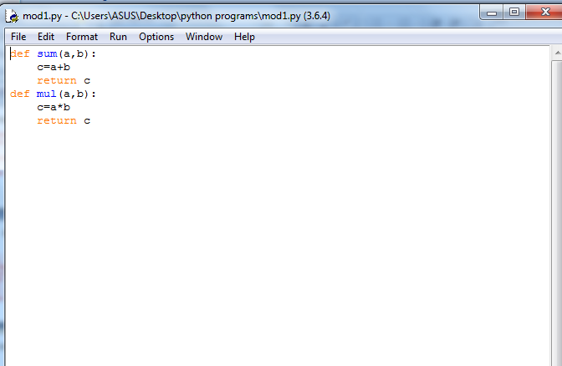
Create Module

Slide 7
With mod1
Import mod1
print(mod1.sum(4,5))
print(mod1.mul(4,5))

Slide 8
from
from mod1 import sum,mul
print(mod1.sum(4,5))
print(mod1.mul(4,5))

Slide 9
With alias
Import mod1 as m
print(m.sum(4,5))
print(m.mul(4,5))

Slide 10
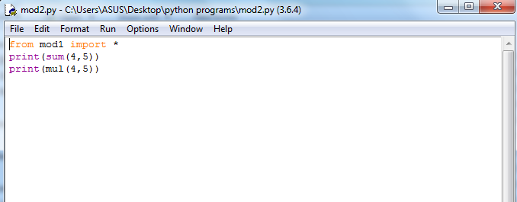

Slide 11
Set
A set is an unordered collection of items. Every element is unique (no duplicates) and must be immutable (which cannot be changed).
However, the set itself is mutable. We can add or remove items from it.
Sets can be used to perform mathematical set operations like union, intersection, symmetric difference etc.

Slide 12
Create set
A set is created by placing all the items (elements) inside curly braces {}, separated by comma or by using the built-in function set().
It can have any number of items and they may be of different types (integer, float, tuple, string etc.). But a set cannot have a mutable element, like list, set or dictionary, as its element.

Slide 13
Set representation
A={1,2,3}
type(A)
<class ‘set’>
a=set([1,2,3])
>>> type(a)
<class 'set'>
>>>a.add(87)

Slide 14
Set Operations
Union is performed using | operator. Same can be accomplished using the method union()
Intersection is performed using & operator. Same can be accomplished using the method intersection().
Difference is performed using - operator. Same can be accomplished using the method difference().
Symmetric difference is performed using ^ operator. Same can be accomplished using the method symmetric_difference().

Slide 15
Example
s1={1,2,3}
s2={2,4,5}
s3=s1.union(s2)
s4=s1.intersection(s2)
s5=s1.difference(s2)
s6=s1.symmetric_difference(s2)
print(s3)
print(s4)
print(s5)
print(s6)

Slide 16
Iterating Through a Set
a=set([1,2,3])
>>> a
{1, 2, 3}
>>> for i in a:
print(a)
{1, 2, 3}
{1, 2, 3}
{1, 2, 3}

Slide 17
Frozenset
Frozenset is a new class that has the characteristics of a set, but its elements cannot be changed once assigned. While tuples are immutable lists, frozensets are immutable sets.
Frozensets can be created using the function frozenset().

Slide 18
a=frozenset([1, 2, 3])
>>> a
frozenset({1, 2, 3})
>>> a.add(4)
Traceback (most recent call last):
File "<pyshell#16>", line 1, in <module>
a.add(4)
AttributeError: 'frozenset' object has no attribute 'add'

Slide 19
Data frame
DataFrame is a 2-dimensional labeled data structure with columns of potentially different types.
You can think of it like a spreadsheet or SQL table, or a dict of Series objects.
It is generally the most commonly used pandas object.
Notes:
hi
bye

Slide 20
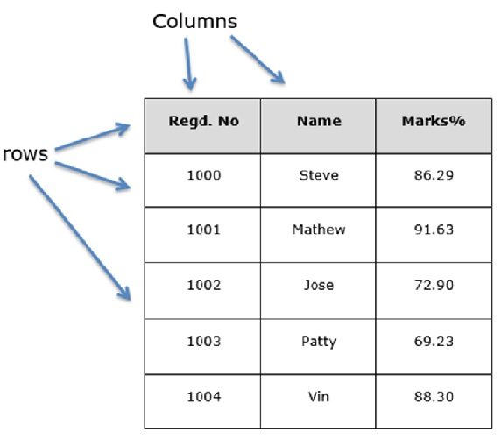
Structure of Data Frame
Notes:
hi
bye

Slide 21
Pandas Dataframe
Pandas is a Python package providing fast, flexible, and expressive data structures designed to make working with “relational” or “labeled” data both easy and intuitive. It aims to be the fundamental high-level building block for doing practical, real world data analysis in Python.
Notes:
hi
bye

Slide 22
>>> import pandas
>>>dataframe=pandas.read_csv("c://python//test.csv")
>>> print(dataframe)
Name Class
0 A 1
1 B 2
2 C 3
3 D 4

